Slide 1
Sentiment Analysis on Restaurant Reviews
CAPSTONE PROJECT
Presented By :
Name: S.V.S.K.ADITYA
Roll No : 22Q75A0516
College: Avanthi Institute of Engineering and Technology
Department: Computer Science and Engineering

Slide 2
OUTLINE
Problem Statement
Proposed System/Solution
System Development Approach
Algorithm & Deployment
Result
Conclusion
Future Scope
References

Slide 3
Problem Statement
Develop a Sentiment Analysis Model to classify restaurant reviews as ‘Positive and Negative’.
There are different types of reviews given by the customers after having their food . It might be positive or negative . So we need to predict how much percentage of good review of entire dataset.
With the rapid expansion of online platforms dedicated to sharing opinions and reviews, restaurants increasingly rely on customer feedback to improve their services and attract new customers. Analyzing the sentiment of these reviews provides valuable insights into customer satisfaction.

Slide 4
Proposed Solution
Develop a robust sentiment analysis model to automatically classify restaurant reviews into positive and negative sentiments.
Data Collection:
Obtain a comprehensive dataset of restaurant reviews from diverse sources such as Yelp, Google Reviews, or Kaggle datasets..
Data Preprocessing:
Clean the raw text data to remove noise and ensure consistency
Remove HTML tags, punctuation, numbers and special characters.
Convert text to lowercase and handle contractions.
Tokenization and removal of stop words.
Stemming & lemmatization for normalization.
Feature Extraction : TFIDF Vectorization, Word cloud
Machine Learning Algorithm:
Implement Multinomial Naive Bayes for sentiment classification
Train the model using the pre-processed dataset.
Tune hyperparameters if necessary (e.g., smoothing parameter alpha).

Slide 5
Proposed Solution
Deployment:
Deploy the Multinomial Naive Bayes model for real-time sentiment analysis
Develop a deployment pipeline to process new restaurant reviews.
Consider scalability and efficiency in handling incoming data.
Evaluation:
Evaluate the performance of the trained model
Calculate accuracy, precision, recall, and F1-score.
Use confusion matrix to visualize true positives, true negatives, false positives, and false negatives.

Slide 6
System Approach
System requirements : 1.Desktop or Laptop with Intel i5 or AMD Ryzen-3 processor.
2.Colab or Jupyter Notebook for program execution
3.Anaconda Navigator
Library required to build the model : 1.Pandas
2.Seaborn
3.Matplotlib
4.Scikit-Learn
5.Word Cloud

Slide 7
Algorithm & Deployment
Algorithm Selection:
Multinomial Naïve Bayes : Chosen for its suitability in text classification tasks, leveraging word frequencies to predict sentiment(positive/negative) based on restaurant reviews
Data Input:
Dataset: Includes restaurant reviews with corresponding sentiment labels (positive/negative).
Preprocessing: Cleaned and tokenized text data to prepare for model training
Training Process:
Feature Extraction: Used TF-IDF (Term Frequency-Inverse Document Frequency) to transform text data into numerical features.
Prediction Process:
Input: New restaurant reviews are processed through the trained model.
Output: Generates predictions of sentiment (positive/negative) for each review based on learned patterns.

Slide 8
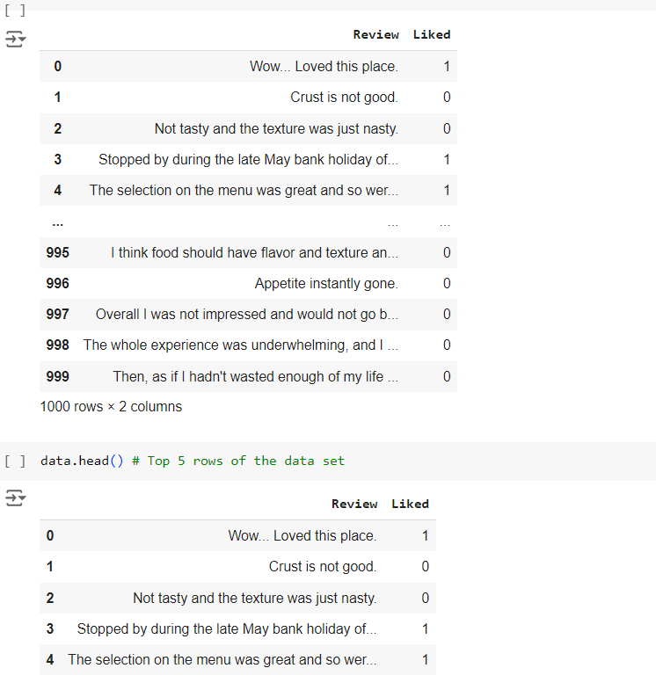
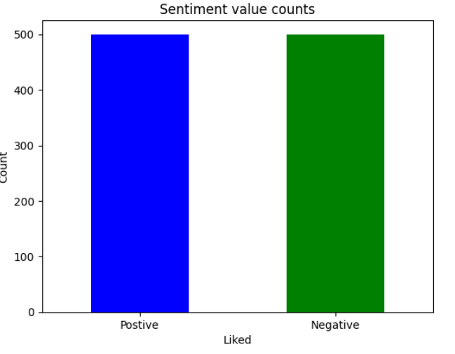
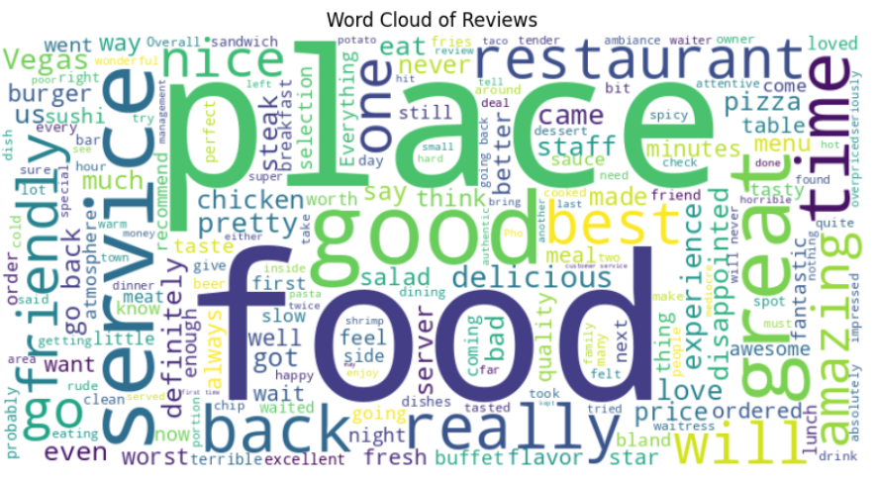
SNAPSHOTS

Slide 9
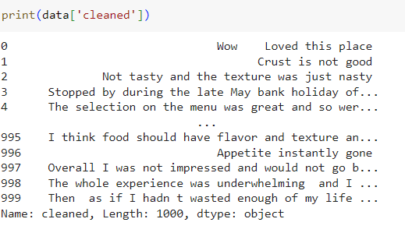
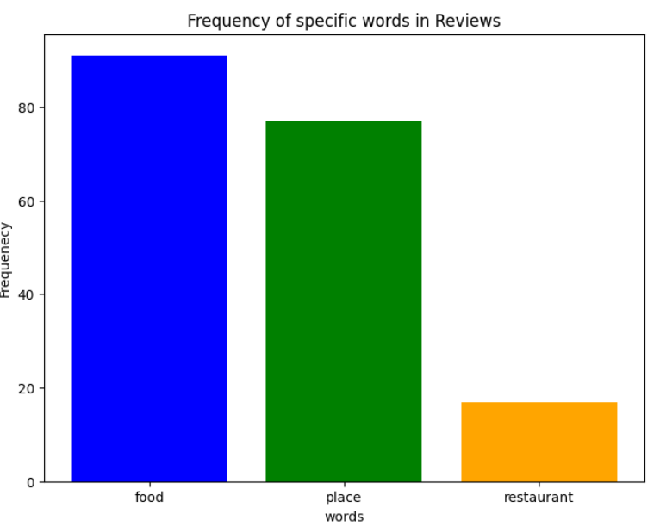
SNAPSHOTS

Slide 10
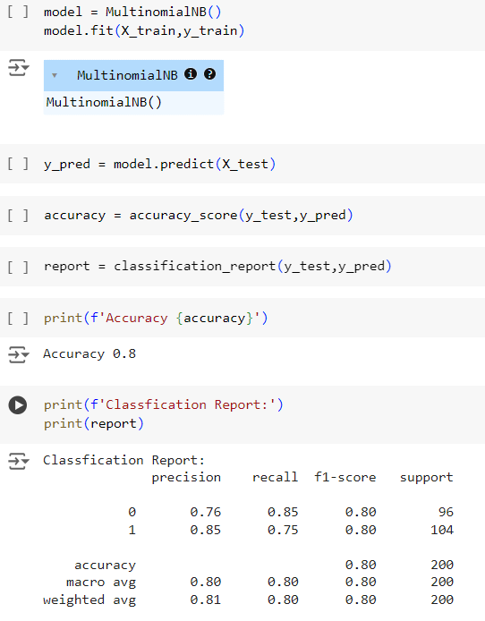
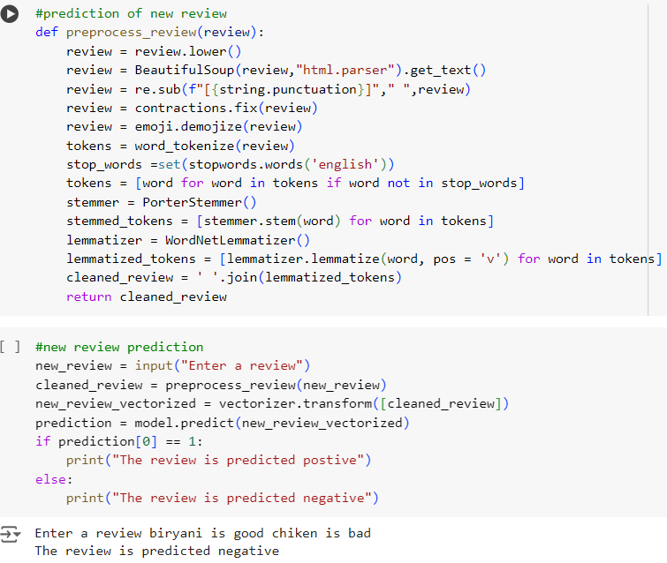
Result
Accuracy Score – 80%
Precision – 85%
Recall – 75%

Slide 11
Conclusion
Summary of Findings and Key Takeaways:
Effective Classification: The Multinomial Naive Bayes algorithm successfully classified restaurant reviews into positive and negative sentiments with notable accuracy.
Actionable Insights: The sentiment analysis model provided valuable insights into customer satisfaction, enabling restaurant owners to make informed decisions to enhance their services.
Scalable Solution: The deployed model proved to be scalable, efficiently handling real-time sentiment analysis of incoming reviews.
Lessons Learned During the Project:
Importance of Data Quality: High-quality, well-preprocessed data is essential for accurate sentiment analysis. Careful cleaning and preprocessing greatly improved model performance.
Feature Engineering: Utilizing TF-IDF for feature extraction effectively captured the textual nuances necessary for the model to understand sentiments.
Model Choice: Multinomial Naive Bayes was a robust choice for this task, though experimenting with other algorithms could provide further insights and improvements.
Deployment Challenges: Integrating the model into a production environment highlighted the importance of addressing scalability and performance issues. Using containerization tools like Docker was beneficial.
Continuous Improvement: Regular updates and retraining of the model with new data are crucial for maintaining accuracy and relevance over time.

Slide 12
Future scope
Opportunities for Further Improvement or Expansion
Model Enhancement:
Experiment with advanced algorithms such as deep learning models (e.g., LSTM, BERT) to potentially improve sentiment classification accuracy.
Incorporate more complex feature extraction techniques like word embeddings (Word2Vec, Glove) for better semantic understanding.
Enhance preprocessing steps to better handle nuances such as sarcasm, slang, and context.
Multilingual Support:
Expand the model to support multiple languages, enabling sentiment analysis for a broader audience.
Use language translation models and multilingual NLP techniques to handle reviews in various languages.
Real-Time Analysis:
Optimize the deployment pipeline for real-time sentiment analysis to provide immediate insights from incoming reviews.
Implement streaming data processing frameworks to handle continuous data flow efficiently.

Slide 13
Future scope
Potential Applications in Other Domains or Industries
Healthcare:
Analyze patient feedback and reviews to gauge satisfaction with medical services and identify areas for improvement.
Monitor social media for sentiment regarding healthcare policies and public health campaigns.
Finance:
Evaluate customer feedback on banking and financial services to improve customer experience and product offerings.
Analyze sentiment in financial news and social media to predict market trends and inform investment strategies.
Retail:
Assess customer reviews and feedback on products and services to enhance product development and marketing strategies.
Use sentiment analysis to monitor brand reputation and respond proactively to negative feedback.
Entertainment:
Analyze audience reviews and social media sentiment about movies, TV shows, and music to inform content creation and marketing.
Monitor fan sentiment to better engage with audiences and tailor experiences to their preferences.

Slide 14
References
DATASET : Reviews.csv
Tools and Libraries:
Python: Programming language used for developing the sentiment analysis model.
scikit-learn: Library used for machine learning algorithms, including Multinomial Naive Bayes.
Pandas: Library for data manipulation and analysis.
NumPy: Library for numerical computations.
NLTK (Natural Language Toolkit): Library for text processing and NLP tasks.
Links:
Sentiment Analysis Tutorial: [AI Session Recording Batch 2 - OneDrive (sharepoint.com)]
Notebook : [ Sentiment_Analysis_code_end to end.ipynb]
Special Thanks to :
EDUNET FOUNDATION
IBM SKILLSBUILD

Slide 15


